Slide 1
Session 25 : Android Notifications
Module 4.3 : Android

Slide 2
Learning Objectives
At the end of the session successful participants will be able to
Understand Notifications
Implement Notification Manager
Implement Notification Methods
Create & Cancel a Notification

Slide 3
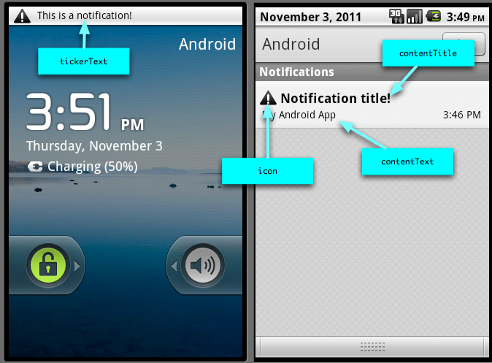
Android Notifications
What Is A Notification?
A notification is a short message briefly displayed on the status line.

Slide 4
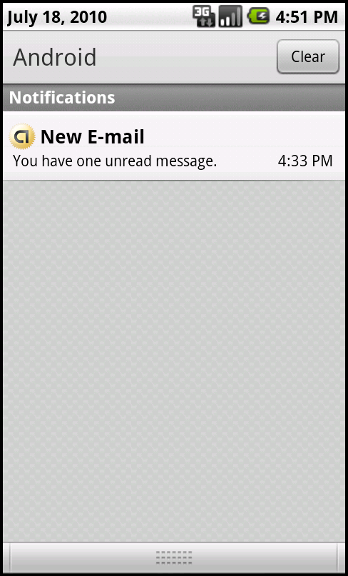
Android Notifications
What Is A Notification?
It typically announces the happening of an special event for which a trigger has been set.
After opening the Notification Panel the user may choose to click on a selection and execute an associated activity.

Slide 5
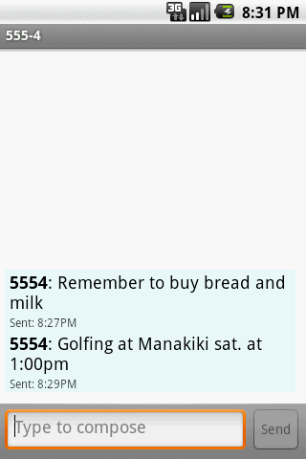
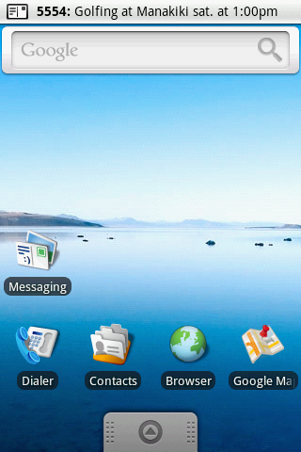
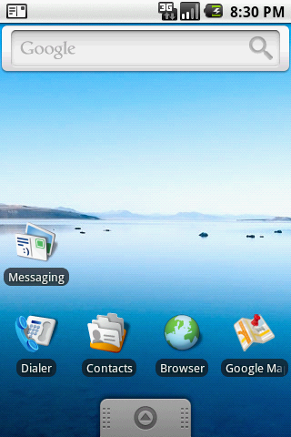
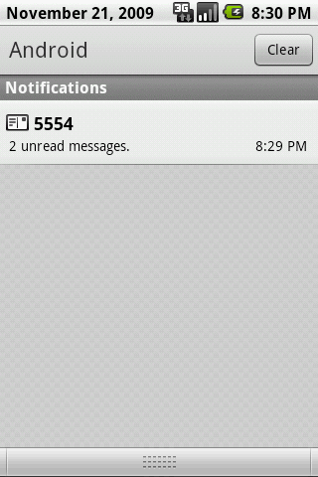
Android Notifications
What Is A Notification?
Notification shown
on the status line
Drag down
Click on Notification Panel to execute associated
application

Slide 6
Android Notifications
Notification Manager
This class notifies the user of events that happen in the background. Notifications can take different forms:
A persistent icon that goes in the status bar and is accessible through the launcher, (when the user selects it, a designated Intent can be launched)
Turning on or flashing LEDs on the device
Alerting the user by flashing the backlight, playing a sound, or vibrating.

Slide 7
Android Notifications
Notification Manager
You do not instantiate this class directly; instead, retrieve it through getSystemService( String ).
Example:
String servName= Context.NOTIFICATION_SERVICE;
notificationManager= (NotificationManager) getSystemService(servName);

Slide 8
Android Notifications
Notification Manager
This class represents how a persistent notification is to be presented to the user using the NotificationManager.
Example:
public Notification(inticon, CharSequencetickerText, long when)
Parameters | Description
icon | The resource id of the icon to put in the status bar.
tickerText | The text that flows by in the status bar when the notification first activates.
when | The time to show in the time field. In the System.currentTimeMillis timebase.

Slide 9
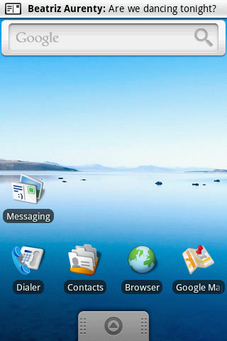
Android Notifications
Notification Methods
Places a persistent notification on the status bar.
public void notify(intid, Notification notification)
Parameters | Description
id | An identifier for this notification unique within your application.
notification | A Notification object describing how to notify the user, other than the view you're providing. Must not be null.

Slide 10
Android Notifications
Notification Methods
Cancel a previously shown notification. If it's transient, the view will be hidden. If it's persistent, it will be removed from the status bar.
public void cancel (intid)
public void cancelAll( )
Parameters | Description
Id | An identifier for this notification unique within your application.

Slide 11
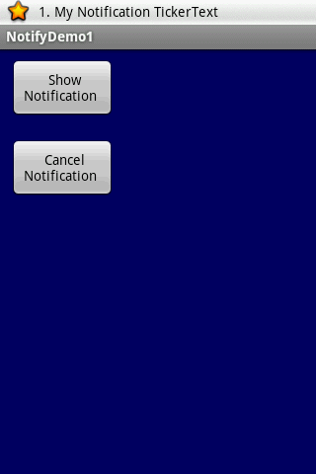
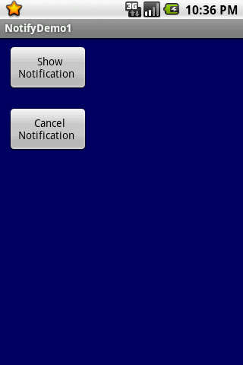
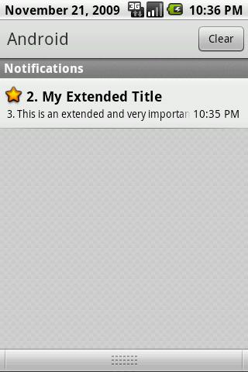
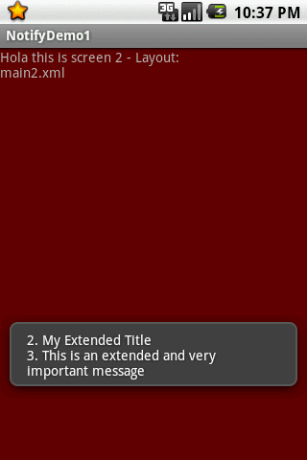
Android Notifications
Notification Methods: Example
Produce a notification. Allow the user to click on the Notification Panel and execute appropriate activity to attend the message.

Slide 12
Android Notifications
Notification Methods: Example
Example – Layouts – main.xml
<?xml version="1.0" encoding="utf-8"?>
<LinearLayout
android:id="@+id/myLinearLayout1"
android:layout_width="fill_parent"
android:layout_height="fill_parent"
android:background="#ff000066"
android:orientation="vertical"
xmlns:android="http://schemas.android.com/apk/res/android" >
<Button
android:id="@+id/btnGo"
android:layout_width="106px"
android:layout_height="61px”

Slide 13
Android Notifications
Notification Methods: Example
Example – Layouts – main.xml
android:layout_margin="10px"
android:text=" Show Notification " >
</Button>
<Button
android:id="@+id/btnStop"
android:layout_width="106px"
android:layout_height="61px"
android:layout_margin="10px"
android:text=" Cancel Notification " >
</Button>
</LinearLayout>

Slide 14
Android Notifications
Notification Methods: Example
Example – Layouts – main2.xml
<?xml version="1.0" encoding="utf-8"?>
<LinearLayout
android:id="@+id/main2LinLayout"
android:layout_width="fill_parent"
android:layout_height="fill_parent"
android:background="#ff660000"
android:orientation="vertical"
xmlns:android="http://schemas.android.com/apk/res/android"
>
<TextView
android:id="@+id/widget29"
android:layout_width="251px”

Slide 15
Android Notifications
Notification Methods: Example
Example – Layouts – main2.xml
android:layout_height="69px"
android:text="Holathis is screen 2 -Layout:main2.xml"
>
</TextView>
</LinearLayout>

Slide 16
Android Notifications
Notification Methods: Example
Example – Manifest
<?xml version="1.0" encoding="utf-8"?>
<manifest xmlns:android="http://schemas.android.com/apk/res/android"
package="cis493.demos"
android:versionCode="1"
android:versionName="1.0">
<application android:icon="@drawable/icon" android:label="@string/app_name">
<activity android:name=".NotifyDemo1"
android:label="@string/app_name">
<intent-filter>
btn_star_big_on_selected.png
Note: Obtain the icon from the folder
C:\Android\platforms\android-1.x\data\res\drawable

Slide 17
Android Notifications
Notification Methods: Example
Example – Manifest
<action android:name="android.intent.action.MAIN" />
<category android:name="android.intent.category.LAUNCHER" />
</intent-filter>
</activity>
<activity android:name=".NotifyHelper" >
</activity>
</application>
<uses-sdkandroid:minSdkVersion="4" />
</manifest>
btn_star_big_on_selected.png
Note: Obtain the icon from the folder
C:\Android\platforms\android-1.x\data\res\drawable

Slide 18
Android Notifications
Notification Methods: Example
Example – Create & Cancel a Notification
package cis493.demos;
import android.app.Activity;
import android.app.Notification;
import android.app.NotificationManager;
import android.app.PendingIntent;
import android.content.Context;
import android.content.Intent;
import android.os.Bundle;
import android.view.View;
import android.view.View.OnClickListener;
import android.widget.*;
////////////////////////////////////////////////////////////

Slide 19
Android Notifications
Notification Methods: Example
Example – Create & Cancel a Notification
public class NotifyDemo1 extends Activity {
Button btnGo;
Button btnStop;
intnotificationId= 1;
NotificationManagernotificationManager;
@Override
public void onCreate(Bundle savedInstanceState) {
super.onCreate(savedInstanceState);
setContentView(R.layout.main);
btnGo= (Button)findViewById(R.id.btnGo);
btnGo.setOnClickListener(newOnClickListener() {
publicvoidonClick(View v) {

Slide 20
Android Notifications
Notification Methods: Example
Example – Create & Cancel a Notification
//define a notification manager
String serName= Context.NOTIFICATION_SERVICE;
notificationManager= (NotificationManager)getSystemService(serName);
//define notification using: icon, text, and timing.
inticon = R.drawable.btn_star_big_on_selected;
String tickerText= "1. My Notification TickerText";
longwhen = System.currentTimeMillis();
Notification notification= newNotification(icon, tickerText, when);
//configure appearance of the notification
String extendedTitle= "2. My Extended Title“;

Slide 21
Android Notifications
Notification Methods: Example
Example – Create & Cancel a Notification
String extendedText= "3. This is an extended and very important message";
// set a Pending Activity to take care of the potential request the user
// may have by clicking on the notification asking for more explanations
Intentintent= newIntent(getApplicationContext(), NotifyHelper.class);
intent.putExtra("extendedText", extendedText);
intent.putExtra("extendedTitle", extendedTitle);
PendingIntentlaunchIntent=
PendingIntent.getActivity(getApplicationContext(),0,intent,0);

Slide 22
Android Notifications
Notification Methods: Example
Example – Create & Cancel a Notification
notification.setLatestEventInfo(getApplicationContext(),
extendedTitle, extendedText, launchIntent);
//trigger notification
notificationId= 1;
notificationManager.notify(notificationId, notification);
}//click
});
/////////////////////////////////////////////////////////////////////////////
btnStop= (Button)findViewById(R.id.btnStop);
btnStop.setOnClickListener(newOnClickListener() {
publicvoidonClick(View v) {

Slide 23
Android Notifications
Notification Methods: Example
Example – Create & Cancel a Notification
//canceling a notification
notificationId= 1;
notificationManager.cancel(notificationId);
}
});
}//onCreate
}//NotifyDemo1

Slide 24
Android Notifications
Notification Methods: Example
Example – SubActivity–Attending the Notification
package cis493.demos;
import android.app.Activity;
import android.content.Intent;
import android.os.Bundle;
import android.widget.Toast;
public class NotifyHelper extends Activity {
@Override
protected void onCreate(Bundle savedInstanceState) {
super.onCreate(savedInstanceState);
setContentView(R.layout.main2);
Intent myData= getIntent();
// extract the extra-data in the Notification

Slide 25
Android Notifications
Notification Methods: Example
Example – SubActivity–Attending the Notification
String msg= myData.getStringExtra("extendedTitle") + "\n"
+ myData.getStringExtra("extendedText");
Toast.makeText(getApplicationContext(), msg, 1).show();
}
}

